Slide 1


Hospital Patient Management System
A Comprehensive Software Architecture for Streamlining Healthcare Operations, OPD/IPD Workflows, and Electronic Health Records.

Slide 2


Executive Summary & Need
Traditional Healthcare Challenges
HPMS System Objectives
Manual hospital workflows suffer from high registration turnaround times, untracked paper medical files, and inefficient bed allocations.
Centralize patient demographics, clinical history, and billing records under a single standardized Unique Health ID (UHID).
Human error in billing and delayed communication between diagnostic labs and doctors frequently compromise patient care outcomes.
Automate appointment queues, streamline IPD bed management, and provide real-time operational insights for administrators.

Slide 3






System Architecture Pillars
OPD & Registration
EHR & Diagnostics
IPD & Billing Core
Generates digital tokens, captures demographics, links national health IDs, and streamlines doctor schedules with real-time token displays.
Centralized longitudinal medical records, e-prescriptions with drug interaction checks, and automated lab test sync.
Live bed matrix tracking across wards, nursing vitals logging, discharge automation, and claim clearinghouse integration.

Slide 4


Patient OPD & Registration Module
•
Single UHID Assignment: Replaces duplicate paper registers with a quick lookup system based on mobile number or biometric ID.
•
Online Appointment Portal: Patients can pre-book consultations via web portal or mobile app to prevent overcrowding.
•
Queue Management: Automated token display screens in waiting lounges reduce perceived wait times and improve flow.
•
Automated Notifications: Instant SMS/WhatsApp confirmation for appointment slots and prescription links.

Slide 5


IPD & Real-Time Bed Management
Admission & Live Matrix
Nursing & Transfer Workflows
Displays real-time occupancy across General Wards, Semi-Private Rooms, and Intensive Care Units (ICU).
Digital shift handoffs ensure continuous monitoring of critical vitals and daily medication administration records (MAR).
Color-coded matrix indicates clean, occupied, reserved, and under-maintenance beds for instant ward boy assignment.
Auto-triggers room, nursing, and equipment charges directly into the final billing ledger upon room transfer.

Slide 6

Electronic Health Records
Clinical Core & Analytics
Provides doctors with instant access to lifelong patient histories, past surgical records, active allergies, and comparative diagnostic trends.
Features structured ICD-10 diagnostic coding, e-prescriptions, and seamless lab integration for safer clinical decision support.

Slide 7
Module Breakdown & Capabilities
Module Name | Core Capabilities | Primary Users | Key Impact
OPD & Registration | Token generation, UHID lookup, appointment booking | Receptionists, Patients | Cuts check-in time by 80%
Clinical EMR | E-prescriptions, lab order sync, ICD coding | Doctors, Nurses | Reduces medical errors
IPD & Bed Manager | Live bed occupancy tracking, ward assignment | Nursing Staff, Admin | Maximizes bed utilization
Pharmacy & Store | Batch tracking, re-order alerts, auto-billing | Pharmacists | Prevents stockouts
Billing & Insurance | Tariff plans, claim generation, audit trail | Finance Desk | Accelerates revenue cycle

Slide 8

Impact & Efficiency Metrics
Quantifiable Operational Gains
65%
By digitizing front-desk patient registration, centralizing lab diagnostic reports, and enabling electronic doctor consultations, the system drastically cuts down total turn-around time per patient visit.
Eliminates revenue leakage in billing by automatically cross-referencing diagnostic orders and ward transfers with payment records.
Wait Time Reduction

Slide 9
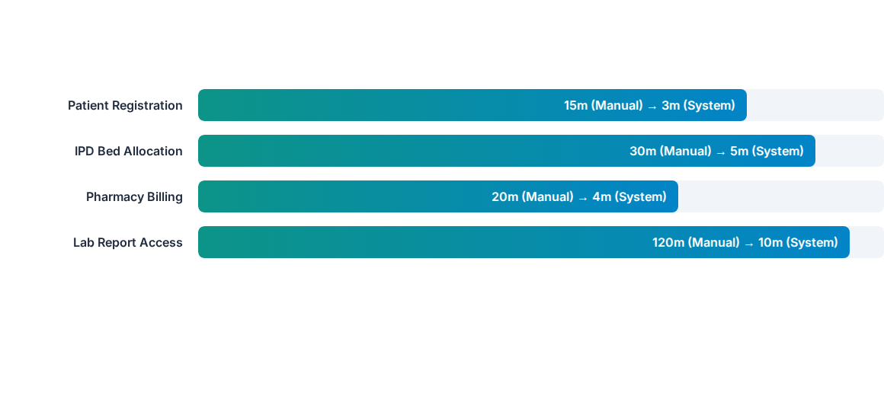
Task Time: Manual vs Automated

Slide 10
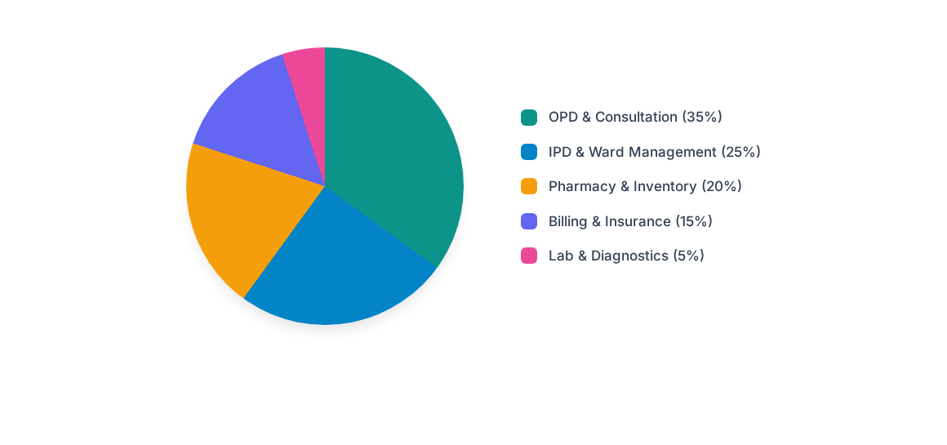
System Module Load Share

Slide 11




System Implementation Roadmap
Phase 2
Phase 4
Clinical EMR, doctor portal & pharmacy inventory sync.
Staff training, security compliance audit & Go-Live.
Phase 1
Phase 3
Requirements gathering, DB design & OPD module deployment.
IPD bed matrix, billing engine & lab LIS integration.

Slide 12
Questions & Discussion
Hospital Patient Management System Presentation

Slide 13


Image Sources
https://curogram.com/hubfs/The%2010%20Best%20Patient%20Check%20In%20System%20%26%20Software%20Solutions%20of%202025-featured.png
Source: curogram.com
https://img.magnific.com/premium-photo/medicine-doctor-use-tablet-review-patient-medical-records-virtual-screens-digital-healthcare-review-medical-reports-carefully-diagnose-illnesses-effective-treatment-plan_568137-1482.jpg
Source: www.magnific.com

